Slide 1
Hi

Slide 2
Open TBS
Change Pic
Chart
Marge

Slide 3

AFTER

Slide 4
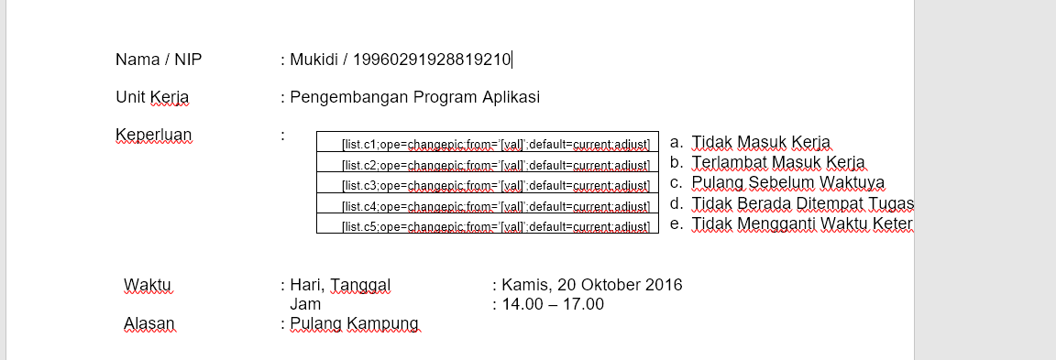
BEFORE

Slide 5
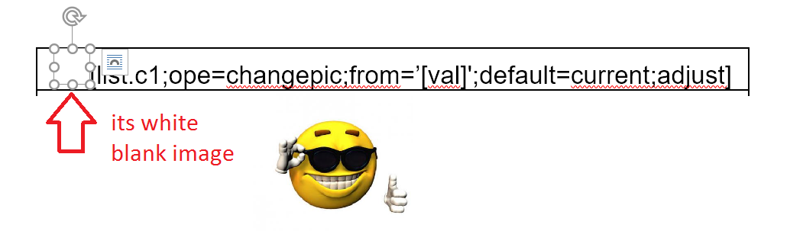
[list.c1;ope=changepic;from=’[val]';default=current;adjust]

Slide 6
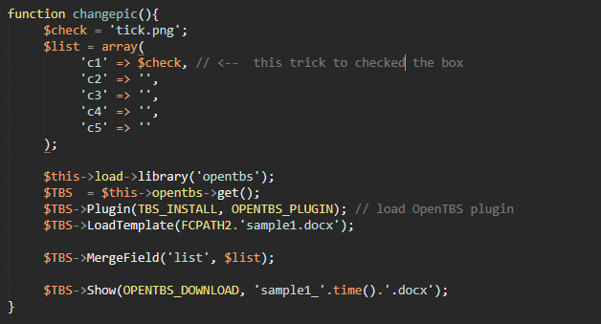

Slide 7
That’s is changepic

Slide 8
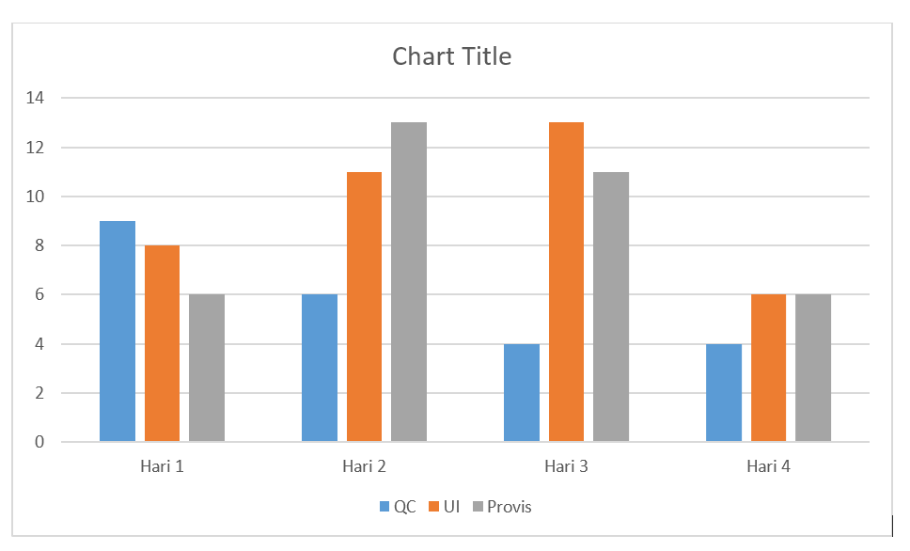

Slide 9
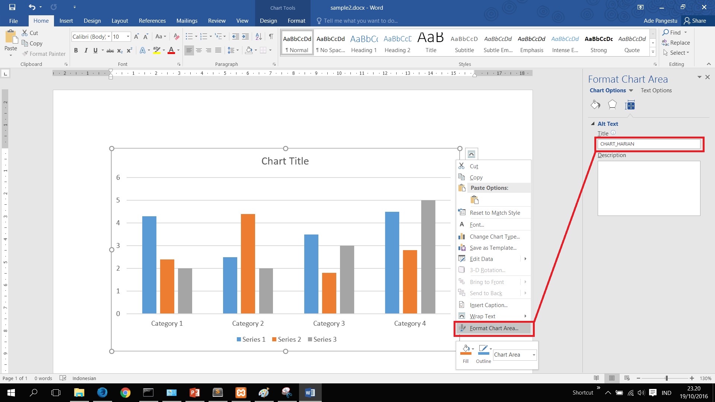

Slide 10
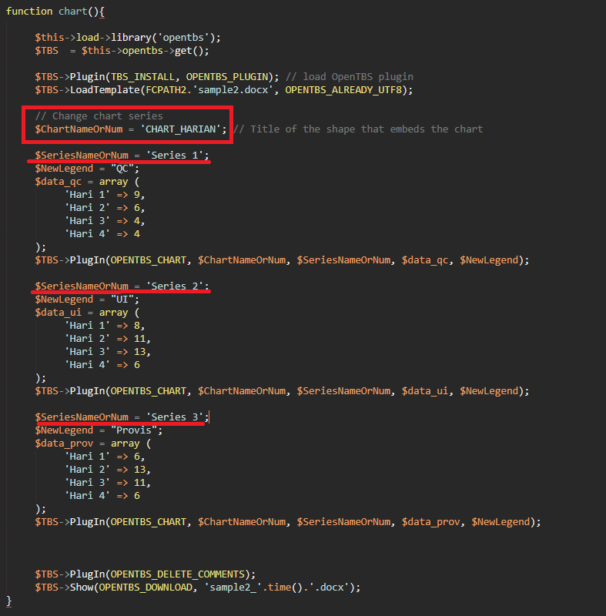

Slide 11
That is .....

Slide 12
Lets try together marge cell open tbs

